Slide 1
Bank Management System
Mentor name: Prof. Shakila Shaikh
Presentation By : Sanyam Jain, Harshit Jain, Yog Sharma
Roll No : N016, N018 , N031

Slide 2
Presentation Agenda
Introduction
Project Overview
Project Workflow (EER)
Technologies Used
Schema Diagram
Query
Self Learning
Lessons Learned
Challenges Faced
References

Slide 3
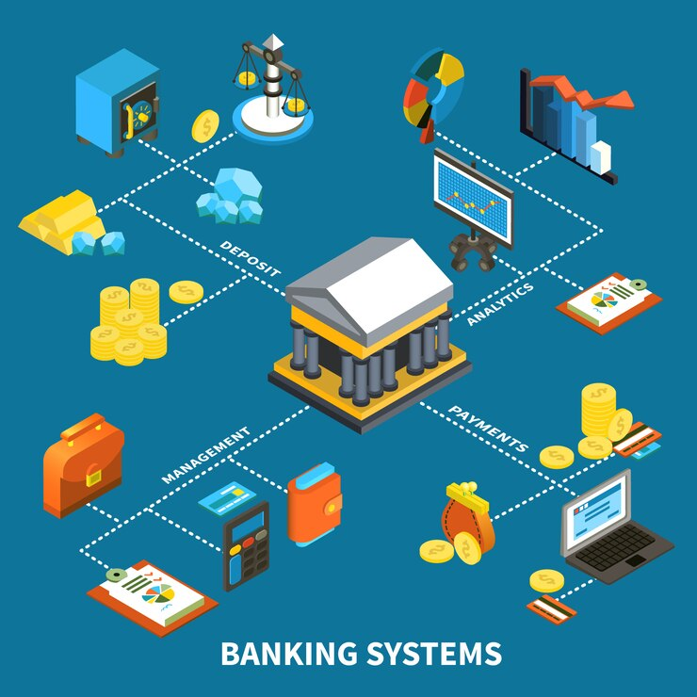
Introduction
The bank management system database is like a big storage room where the bank keeps all important information. This includes things like details about customers, their accounts, transactions, loans, and cards. It helps the bank do its job smoothly by managing things like opening accounts, handling transactions, giving out loans, and managing cards. The database also makes sure that all the information is kept safe and follows the rules set by the government. It can also create useful reports and analyse data to help the bank make smart decisions and keep everything running smoothly and safely.

Slide 4
Project Overview
Goal: The Bank Management System aims to streamline banking operations by consolidating various services into a unified platform.
What it Does: It handles tasks such as account management, transaction processing, loan approvals, customer support, and financial reporting.
For Customers: It provides an easy way for customers to manage their accounts, transfer funds, apply for loans, and access banking services online or through mobile apps.
For Bank Staff: It assists staff in handling customer requests, analyzing financial data, generating reports, monitoring transactions for fraud, and managing banking operations efficiently.
Using Tech: Utilizing technologies like AI, machine learning, and data analytics, the system can improve decision-making, detect suspicious activities, automate routine tasks, and enhance overall customer experience.
Big Picture: The system aims to transform banking operations, making them more convenient for customers, improving security measures, optimizing resource allocation, and driving better financial outcomes for both customers and the bank.

Slide 5
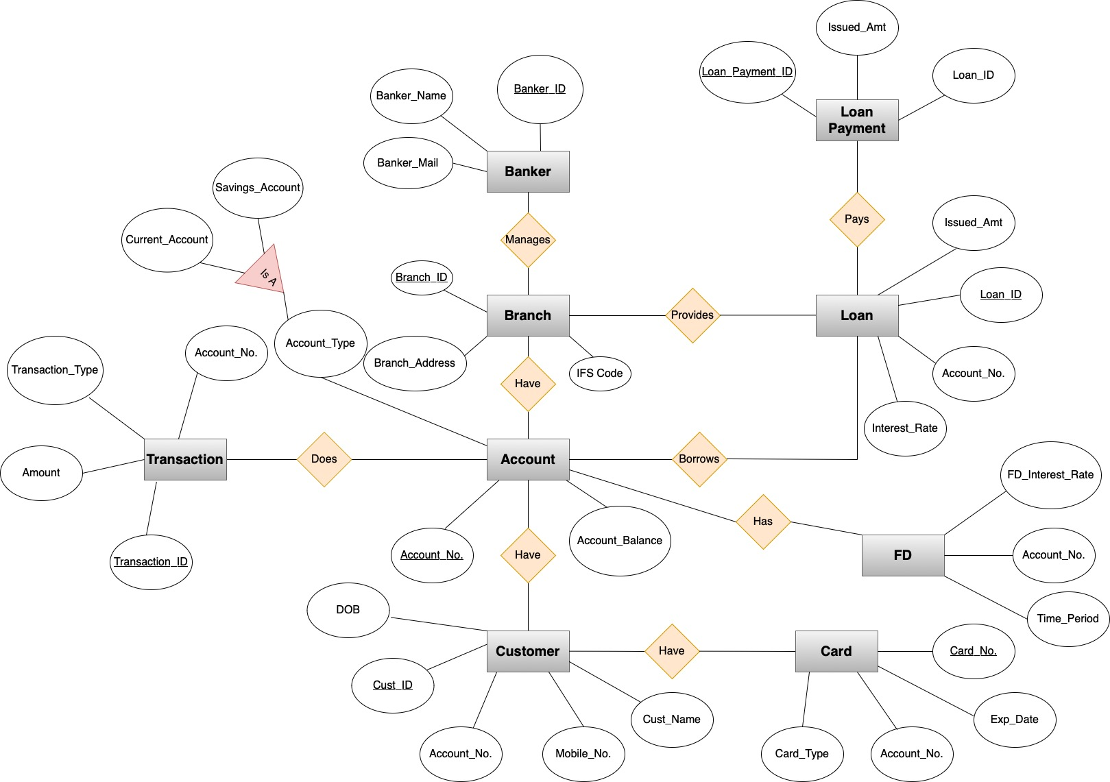
Project Workflow (EER)

Slide 6


Technologies Used
MySQL Workbench
Draw.io

Slide 7
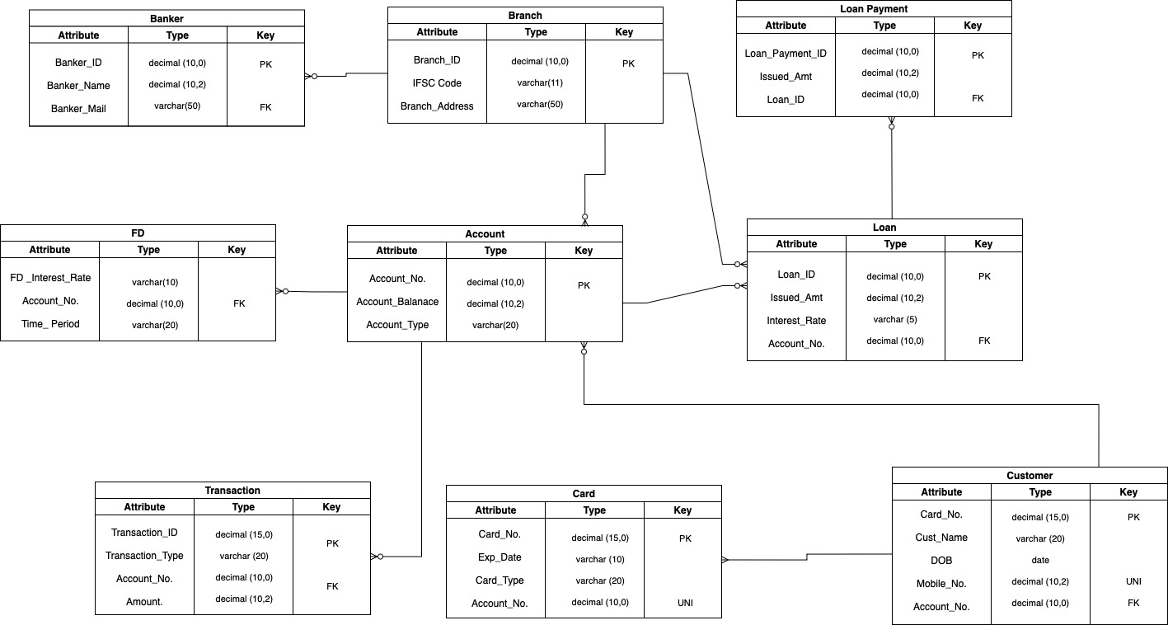
Schema Diagram

Slide 8
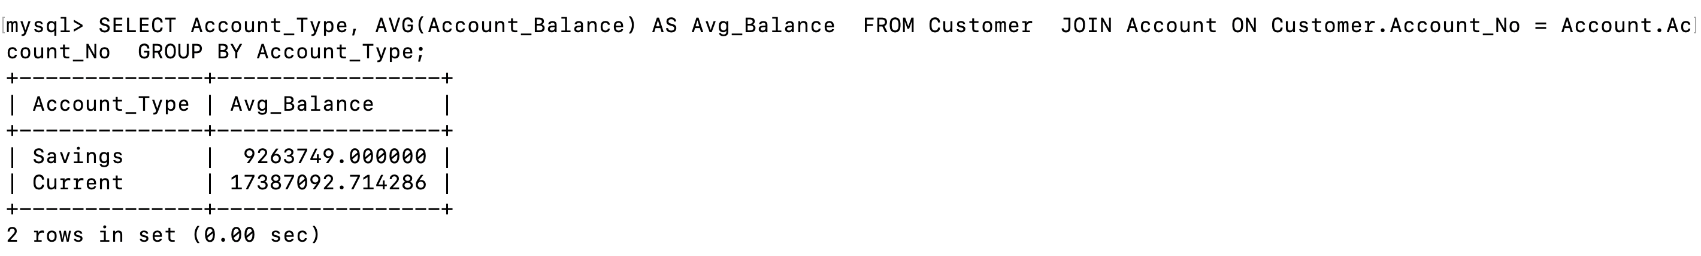
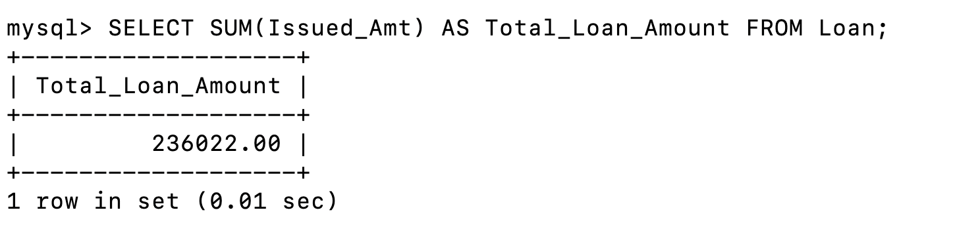
Query
Group customers by account type and calculate the average balance for each type.
Calculate the sum of issued amounts for all loans.

Slide 9
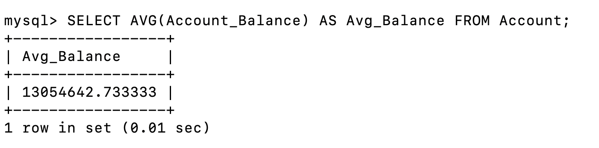
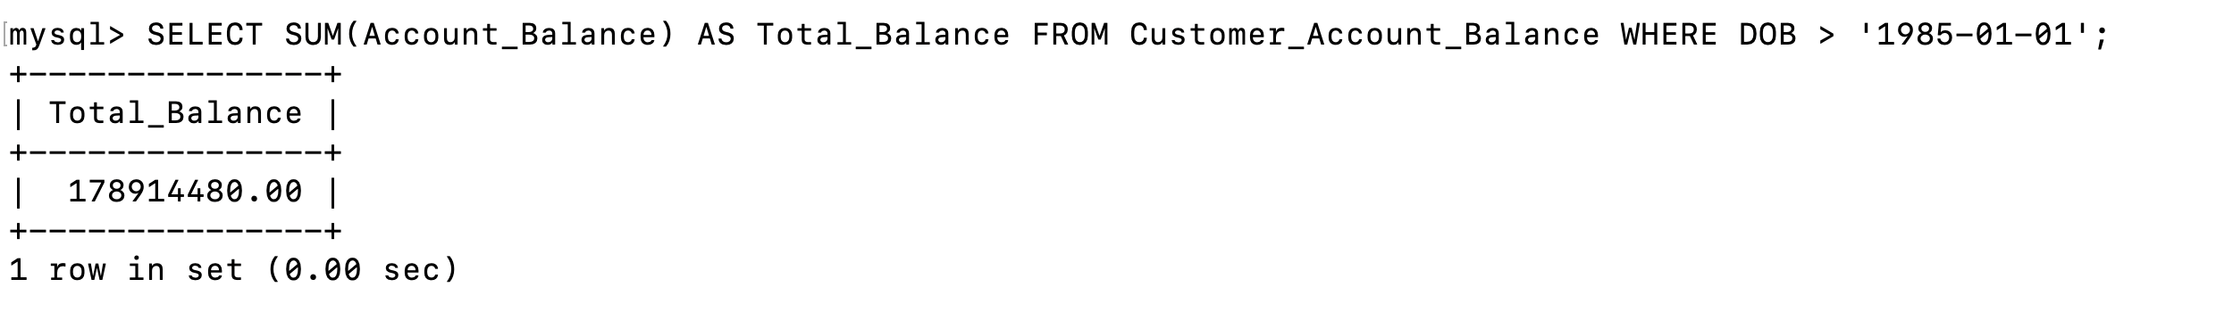
Query
Find the average account balance across all accounts.
Find the total balance of all accounts held by customers born after 1985 from the view.

Slide 10
Self Learning
We learned how to organize data about accounts, transactions, loans, customers, staff, and financial reports using tables and relationships in a bank management system.
We were able to integrate modern-day technology with long-standing banking challenges.
We gained hands-on experience and practical knowledge about database management specific to banking operations.
We now have a better understanding of how to create, manage, and use databases effectively in a banking environment.

Slide 11
Lessons Learned
We learned how to ensure data is properly organized to prevent duplication and maintain accuracy in a bank management system.
We also mastered techniques to optimize SQL queries for improved efficiency and faster data retrieval.
The project enhanced our problem-solving skills as we tackled challenges and found effective solutions while working on database management tasks.

Slide 12
Challenges Faced
In the bank management system project, the first challenge was designing an effective database schema to represent all necessary entities and their relationships accurately.
The second challenge involved managing data consistency to ensure the database remained accurate and up-to-date.
The third challenge was optimizing database performance, particularly when dealing with large datasets or complex queries.

Slide 13
References
https://www.w3schools.com/sql/sql_syntax.asp https://www.geeksforgeeks.org/database-schemas/
https://www.codecademy.com/article/sql-commands https://www.geeksforgeeks.org/enhanced-er-model/

